Slide 1

Basic Discrete Structure : Function
Lecture 7-8
1

Slide 2
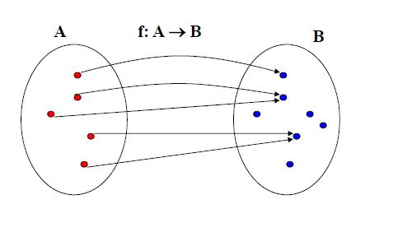
Function
Definition: Let A and B be two sets. A function from A to B, denoted f : A → B , is an assignment of exactly one element of B to each element of A. We write f(a) = b to denote the assignment of b to an element a of A by the function f.
2

Slide 3
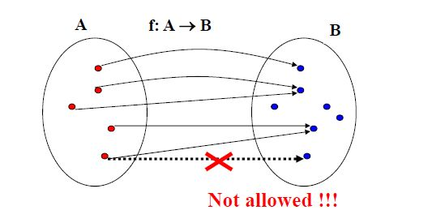
Function
Definition: Let A and B be two sets. A function from A to B, denoted f : A → B , is an assignment of exactly one element of B to each element of A. We write f(a) = b to denote the assignment of b to an element a of A by the function f.
3

Slide 4
Representing Function
Representations of functions:
1. Explicitly state the assignments in between elements of the two sets
2. Compactly by a formula. (using ‘standard’ functions)
Example1:
• Let A = {1,2,3} and B = {a,b,c}
• Assume f is defined as:
• 1 → c
• 2 → a
• 3 → c
• Is f a function ?
• Yes. since f(1)=c, f(2)=a, f(3)=c. each element of A is assigned an element from B
4

Slide 5
Representing Function
Representations of functions:
1. Explicitly state the assignments in between elements of the two sets
2. Compactly by a formula. (using ‘standard’ functions) Example 2:
• Let A = {1,2,3} and B = {a,b,c}
• Assume g is defined as:
• 1 → c
• 1 → b
• 2 → a
• 3 → c
• Is g a function ?
5

Slide 6
Representing Function
Representations of functions:
1. Explicitly state the assignments in between elements of the two sets
2. Compactly by a formula. (using ‘standard’ functions) Example 2:
• Let A = {1,2,3} and B = {a,b,c}
• Assume g is defined as:
• 1 → c
• 1 → b
• 2 → a
• 3 → c
• Is g a function ?
• No. since g(1) is assigned both c and b.
6

Slide 7
Representing Function
Representations of functions:
1. Explicitly state the assignments in between elements of the two sets
2. Compactly by a formula. (using ‘standard’ functions)
Example 3:
• A = {0,1,2,3,4,5,6,7,8,9}, B = {0,1,2}
• Define h: A → B as:
h(x) = x mod 3.
• (the result is the remainder after the division by 3)
• Assignments:
• 0 →0 3 → 0
• 1 → 1 4 → 1
• 2 → 2 …
7

Slide 8
Notation of Set
Definitions: Let f be a function from A to B. • We say that A is the domain of f and B is the codomain of f. • If f(a) = b, b is the image of a and a is a pre-image of b. • The range of f is the set of all images of elements of A. Also, if f is a function from A to B, we say f maps A to B.
Example: Let A = {1,2,3} and B = {a,b,c} • Assume f is defined as: 1 → c, 2 → a, 3 → c • What is the image of 1? • 1 → c c is the image of 1 • What is the pre-image of a? • 2 → a 2 is a pre-image of a. • Domain of f ? {1,2,3} • Codomain of f ? {a,b,c} • Range of f ? {a,c}
8

Slide 9
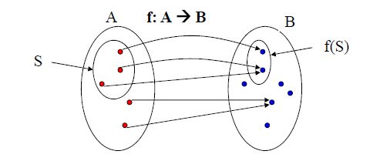
Image of subset
Definition: Let f be a function from set A to set B and let S be a subset of A. The image of S is a subset of B that consists of the images of the elements of S. We denote the image of S by f(S), so that f(S) = { f(s) | s ϵ S }.
Example:
• Let A = {1,2,3} and B = {a,b,c} and f: 1 → c, 2 → a, 3 → c • Let S = {1,3} then image f(S) = ?
9

Slide 10
Image of subset
Definition: Let f be a function from set A to set B and let S be a subset of A. The image of S is a subset of B that consists of the images of the elements of S. We denote the image of S by f(S), so that f(S) = { f(s) | s ϵ S }.
Example:
• Let A = {1,2,3} and B = {a,b,c} and f: 1 → c, 2 → a, 3 → c • Let S = {1,3} then image f(S) = {c}
10

Slide 11
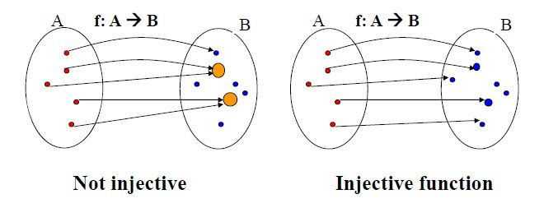
Injective function
Definition: A function f is said to be one-to-one, or injective, if and only if f(x) = f(y) implies x = y for all x, y in the domain of f. A function is said to be an injection if it is one-to-one.
A function for which every element of the range of the function corresponds to exactly one element of the domain.
11

Slide 12
Injective function
Example 1: Let A = {1,2,3} and B = {a,b,c}
• Define f as
– 1 → c
– 2 → a
– 3 → c
• Is f one to one?
12

Slide 13
Injective function
Example 1: Let A = {1,2,3} and B = {a,b,c} • Define f as – 1 → c – 2 → a – 3 → c • Is f one to one? • No, it is not one-to-one • since f(1) = f(3) = c, and 1 ≠ 3.
Example 2: Let g : Z →Z, where g(x) = 2x - 1. • Is g one-to-one?
13

Slide 14
Injective function
Example 1: Let A = {1,2,3} and B = {a,b,c} • Define f as – 1 → c – 2 → a – 3 → c • Is f one to one? • No, it is not one-to-one • since f(1) = f(3) = c, and 1 ≠ 3.
Example 2: Let g : Z →Z, where g(x) = 2x - 1. • Is g is one-to-one? • Yes. • Why? 14

Slide 15
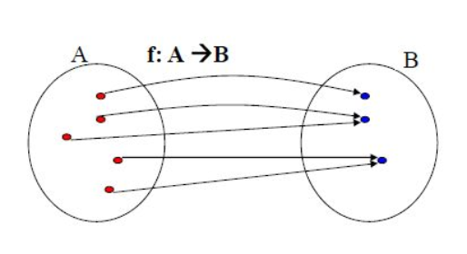
Surjective function
Definition: A function f from A to B is called onto, or surjective, if and only if for every b ϵ B there is an element a ϵ A such that f(a) = b.
Alternative: all co-domain elements are covered
15

Slide 16
Surjective function
Example 1: Let A = {1,2,3} and B = {a,b,c}
– Define f as
• 1 → c
• 2 → a
• 3 → c
• Is f an onto?
16

Slide 17
Surjective function
Example 1: Let A = {1,2,3} and B = {a,b,c} – Define f as • 1 → c • 2 → a • 3 → c • Is f an onto? • No. f is not onto, since b ϵ B has no pre-image.
Example 2: A = {0,1,2,3,4,5,6,7,8,9}, B = {0,1,2} – Define h: A → B as h(x) = x mod 3. • Is h an onto function?
17

Slide 18
Surjective function
Example 1: Let A = {1,2,3} and B = {a,b,c} – Define f as • 1 → c • 2 → a • 3 → c • Is f an onto? • No. f is not onto, since b ϵ B has no pre-image.
Example 2: A = {0,1,2,3,4,5,6,7,8,9}, B = {0,1,2} – Define h: A → B as h(x) = x mod 3. • Is h an onto function? • Yes. h is onto since a pre-image of 0 is 6, a pre-image of 1 is 4, a pre-image of 2 is 8.
18

Slide 19

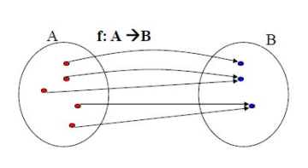
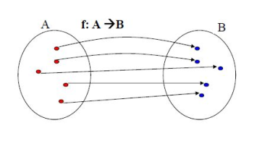
Bijective function
Definition: A function f is called a bijection if it is both one-to one and onto.
onto
19
One to one and onto

Slide 20
Bijective function
Example 1:
• Let A = {1,2,3} and B = {a,b,c}
– Define f as
• 1 → c
• 2 → a
• 3 → b
• Is f a bijection?
20

Slide 21
Bijective function
Example 1:
• Let A = {1,2,3} and B = {a,b,c}
– Define f as
• 1 → c
• 2 → a
• 3 → b
• Is f is a bijection? Yes. It is both one-to-one and onto.
21

Slide 22
Bijective function
Example 2:
• Define g : W → W (whole numbers), where g(n) = [n/2] (floor function).
• 0 → [0/2] = [0] = 0
• 1 → [1/2] = [1/2] = 0
• 2 → [2/2] = [1] = 1
• 3 → [3/2] = [3/2] = 1
• ...
• Is g a bijection?
– No. g is onto but not 1-1 (g(0) = g(1) = 0 however 0 ≠ 1.
22

Slide 23
Bijective function
Theorem. Let f be a function from a set A to itself, where A is finite. Then f is one-to-one if and only if f is onto.
Please note the above is not true when A is an infinite set.
• Example:
– f : Z → Z, where f(z) = 2 * z.
– f is one-to-one but not onto.
• 1 → 2
• 2 → 4
• 3 → 6
– 3 has no pre-image.
26

Slide 24
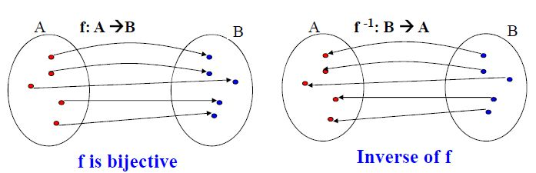
Inverse Function
Definition: Let f be a bijection from set A to set B. The inverse function of f is the function that assigns to an element b from B the unique element a in A such that f(a) = b.
The inverse function of f is denoted by f-1. Hence, f-1 (b) = a, when f(a) = b. If the inverse function of f exists, f is called invertible.
38

Slide 25
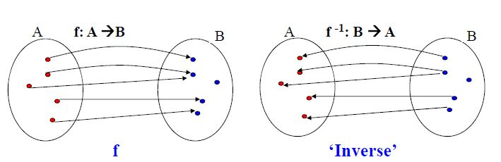
Inverse Function
Note: if f is not a bijection then it is not possible to define the inverse function of f. Why?
Assume f is not one-to-one: ?
39

Slide 26
Inverse Function
Note: if f is not a bijection then it is not possible to define the inverse function of f. Why?
Assume f is not one-to-one:
Inverse is not a function. One element of B is mapped to two different elements.
40

Slide 27
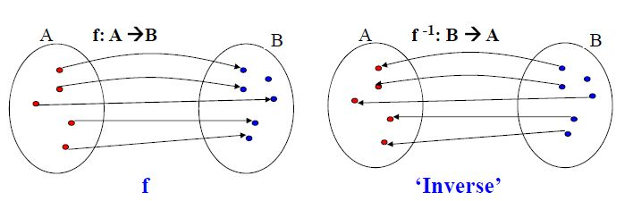
Inverse Function
Note: if f is not a bijection then it is not possible to define the inverse function of f. Why?
Assume f is not onto: ?
41

Slide 28
Inverse Function
Note: if f is not a bijection then it is not possible to define the inverse function of f. Why?
Assume f is not onto:
Inverse is not a function. One element of B is not assigned any value in A.
42

Slide 29
Inverse Function
Example 2:
• Let g : R → R, where g(x) = 2x - 1.
• What is the inverse function g-1 ?
44

Slide 30
Inverse Function
Example 2:
• Define g-1(y) = x= (y+1)/2 ; g-1(x)=(x+1)/2
Test the correctness of inverse:
45
• Let g : R → R, where g(x) = 2x - 1.
g(x)=y => x=g-1(y)
• What is the inverse function g-1 ? Approach to determine the inverse: y = 2x - 1 => y + 1 = 2x
=> (y+1)/2 = x
• g(3) = ..

Slide 31
Inverse Function
Example 2:
• Define g-1(y) = x= (y+1)/2
• g-1 (5) =
• Let g : R → R, where g(x) = 2x - 1.
• What is the inverse function g-1 ? Approach to determine the inverse: y = 2x - 1 => y + 1 = 2x
=> (y+1)/2 = x
Test the correctness of inverse: • g(3) = 2*3 - 1 = 5
46

Slide 32
Inverse Function
Example 2:
• Define g-1(y) = x= (y+1)/2
47
• Let g : R → R, where g(x) = 2x - 1.
• What is the inverse function g-1 ? Approach to determine the inverse: y = 2x - 1 => y + 1 = 2x
=> (y+1)/2 = x
Test the correctness of inverse: • g(3) = 2*3 - 1 = 5
• g-1 (5) = (5+1)/2 = 3

Slide 33
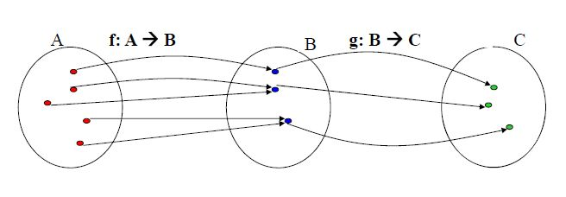
Composition of Function
Definition: Let f be a function from set A to set B and let g be a function from set B to set C. The composition of the functions g and f, denoted by g O f is defined by (g O f)(a) = g(f(a)).
48

Slide 34
Composition of Function
Example 1:
• Let A = {1,2,3} and B = {a,b,c,d}
g : A → A, 1 →3 | f: A → B 1 → b
2 →1 2 → a
3 →2 3 → d
49

Slide 35
Composition of Function
Example 1:
• Let A = {1,2,3} and B = {a,b,c,d}
g : A → A, 1 →3 | f: A → B 1 → b
2 →1 2 → a
3 →2 3 → d
g O f : A → B:
50
• 1 → d
• 2 → b
• 3 → a

Slide 36
Composition of Function
Example 2:
• g O f : Z → Z
• (g O f)(x) = ?
51
• Let f and g be two functions from Z to Z, where
• f(x) = 2x and g(x) = x2.
• f O g : Z → Z
• (f O g)(x) = f(g(x))
= f( x2 ) = 2(x2)

Slide 37
Composition of Function
Example 2:
• g O f : Z → Z
• (g O f)(x) = g(f(x))
• Let f and g be two functions from Z to Z, where
• f(x) = 2x and g(x) = x2.
• f O g : Z → Z
• (f O g)(x) = f(g(x))
= f( x2 ) = 2(x2)
= g(2x) = 4x^2
52

Slide 38
Composition of Function
Example 3:
• (f O f-1)(x) = x and (f-1 O f)(x) = x, for all x.
• Let f : R → R, where f(x) = 2x – 1 and f-1 (x) = (x+1)/2.
= (x+1) - 1 = x
53
• (f O f-1 )(x) = f(f-1 (x)) = f( (x+1)/2 ) = 2( (x+1)/2 ) - 1

Slide 39
Composition of Function
Example 3:
• (f O f-1)(x) = x and (f-1 O f)(x) = x, for all x.
• Let f : R → R, where f(x) = 2x – 1 and f-1 (x) = (x+1)/2.
= (x+1) - 1 = x
= (2x)/2 = x
• (f O f-1 )(x) = f(f-1 (x)) = f( (x+1)/2 ) = 2( (x+1)/2 ) - 1
•(f-1 O f)(x) = f-1 (f(x)) = f-1 ( 2x - 1 )
54

Slide 40

Some Function
Definitions:
• The floor function assigns a real number x the largest integer
that is less than or equal to x. The floor function is denoted by .
• The ceiling function assigns to the real number x the smallest integer that is greater than or equal to x. The ceiling function is denoted by ⌈x⌉
Other important functions: • Factorials: n! = n(n-1) such that 1! = 1
55

Slide 41
Thank You
56

